Slide 1
Open Educational Designs (OED)
A Taxonomy for Differentiating and Classifying Open Learning Environments
Fredrick w. Baker iii
Daniel W. Surry
University of South Alabama

Slide 2
Additional Resources available at
http://www.fredwbaker.com/openeducationaldesigns/

Slide 3
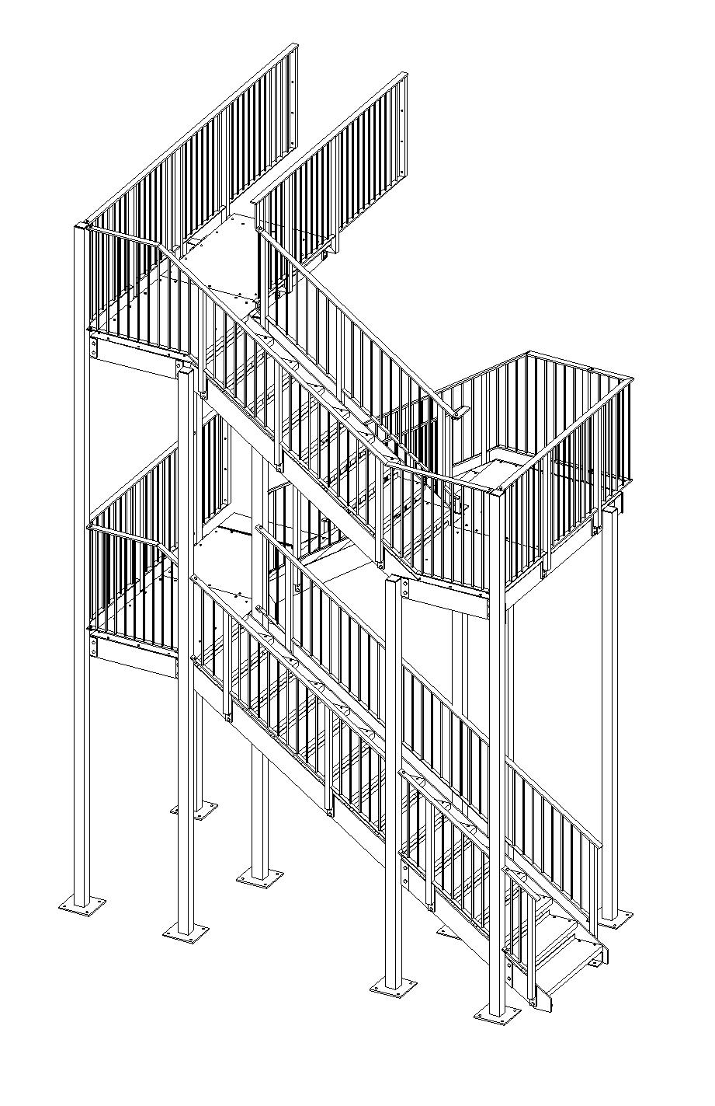
The path
Openness
Designing Open Learning Environments
OEDs Taxonomy
Benefits and Drawbacks
Conclusion
http-//www.kdsdesign.co.uk/STAIRS

Slide 4
Openness
http://www.flickr.com/photos/opensourceway/6555466069/sizes/l/in/photostream/

Slide 5
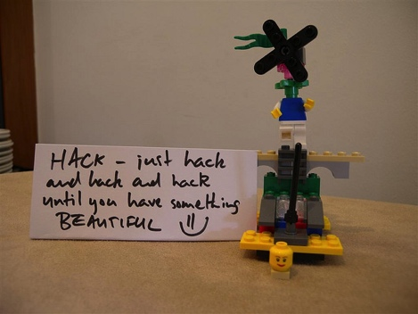
Open Education as Experimentation
The rise of digital technologies are enabling a Grand Experiment in the approach to education.
(the power is shifting to the people-everyone now has a voice)
http://www.flickr.com/photos/11088569@N03/3694320116/sizes/z/in/photostream/

Slide 6
Connective/Social Digital Technologies

Slide 7
Open Digital Technologies

Slide 8
Connective Digital technologies enable
New/Expanded Methods of Teaching & Learning
Transparency in the learning ecosystem,
communities of practice,
scaffolding,
assessment,
assignments, etc.

Slide 9
Connective Digital technologies enable
Lifelong learning
Students and educators are constantly learning and growing, expanding skills, & leaving comfort zones
Tons of resources are accessible and platforms to share on are plentiful

Slide 10
Connective Digital technologies enable
Organic system structures to grow between learners, experts, educators, and people with common interests
Collaboration through sharing and processing ideas
Open dialogues between all parties
These occur UNDER design constraints and in the presence of an educator!

Slide 11
Open Education as Experimentation
An open dialogue is taking place between learners and educators, and the line between the two is blurring

Slide 12
Designing an open Learning Environment
http://opendesignnow.org/wp-content/themes/odn/images/clip.png

Slide 13
Open Learning Environments emphasize
Principles of Openness
Transparency, and
Freedom (minimal barriers/inhibitors)
Sharing
Access
Learner Agency
Connectivity
Open Pedagogy & Scholarship
Collaborative & Participatory Learning
Performance Assessments over Standardized Assessments
Formative Evaluation & Transparent Feedback
Modeling & Scaffolding
Holistic Perspectives on Learners
Baker III, (2012)

Slide 14
Rules common for the Open classroom
Freedom Rule
Learners should have freedom [and ownership] over their own educational endeavors (Agency)
Environment Rule
Must create resource rich environments with a plethora of opportunities
Personalization Rule
Instruction that is personalized where possible and obligates learners to educationally worthwhile goals
Respect Rule
Respect for the learners, always.
Tunnell (1975)

Slide 15
I’m tired of it too!
MOOC
MOOC
MOOC
MOOC
MOOC
MOOC
MOOC
MOOC
MOOC
MOOC
MOOC
MOOC
MOOC
MOOC
MOOC
MOOC
Massively open blahblahblah
MOOC
MOOC
MOOC
MOOC
MOOC
MOOC
MOOC
MOOC
MOOC
MOOC
MOOC
MOOC
MOOC
MOOC
MOOC
MOOC
MOOC
MOOC
MOOC
MOOC
MOOC
MOOC
MOOC
MOOC
MOOC
MOOC

Slide 16
Different Models
http://bombod.com/wp-content/uploads/2011/10/lacoste-shorts-different-models-lacoste-picture.jpg

Slide 17
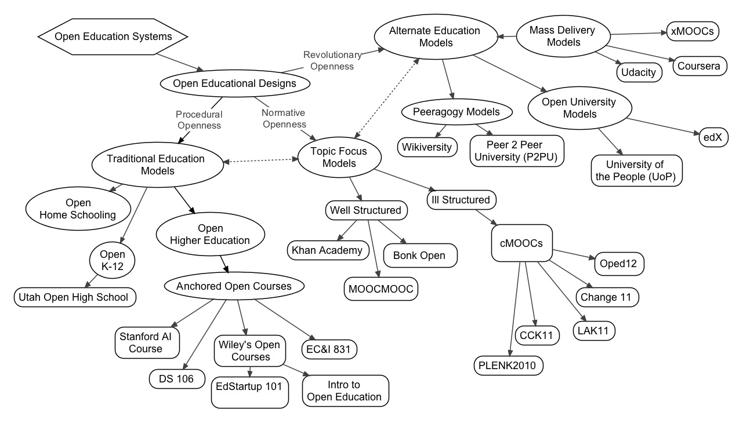
Taxonomy of Open Education Designs
Baker III, and Surry (in press)

Slide 18
Taxonomy of Open Education Designs
Open Education Designs
An overarching term to refer to learning environments which are designed with the characteristics of openness
Open is a continuous construct, not binary.
Can be slightly open-allowing access to outsiders or sharing content, or
Can be fully open- fully transparent, minimal barriers, a focus on creating and maintaining accessibility, sharing, agency, and connectivity
Baker III, and Surry (in press)

Slide 19
Taxonomy of Open Education Designs
Alternate Education Models (Revolutionary Openness):
Seek to overturn/supplant existing educational structures
Examples: Edx, xMOOCs (institutional): Coursera, Udacity
Topic Focus Models (Normative Openness):
Seek ideal, universal education structures. Self –selective DIY education:
Examples: Khan Academy, cMOOCs (connectivist) #Change11 MOOC
Traditional Education Structures (Procedural Openness):
Seek to modify traditional structures to be more open and connected- focus on procedure and expanding borders
Examples: DS106 at University of Mary Washington, David Wiley’s Introduction to Open Education course at Brigham Young University, Open High School of Utah.
Baker III, and Surry (in press)

Slide 20
Differentiating Open Courses
Different foci
What is the purpose/goal of the course?
What is it’s reason for existence?
Share content? Promote something? Learn?
Is the course attached to a larger organization?
Is that organization for profit? for education? for the advancement of some agenda?
Different degrees of openness (openness is a continuous construct, not binary)
Can you access all data and materials without signing up?
Does the course hub aggregate the work of others? Or do you just get one perspective?
Are you allowed/encouraged to share?
Baker III, and Surry (in press)

Slide 21
Important Questions in Open Education Design
Who owns/controls the data?
2.5 quintillion bytes per day according to IBM (IBM, 2013)
How do we define, operationalize, measure, and track success?
Assessment types, constraints, objectives, etc.
How do we build in scaffolding, authenticity, transformative learning, and participation while retaining learner agency and freedom?
Resource provision, assignment development, procedures and requirements, etc.
How do we research and implement innovative and effective learning practices without dictating methods and approaches?
Top down approach vs. bottom up, design based research vs. theoretically driven or practically driven, etc.
Does technology drive education decisions, or does education drive technology decisions?
Shift toward hybrid/online dominant education

Slide 22
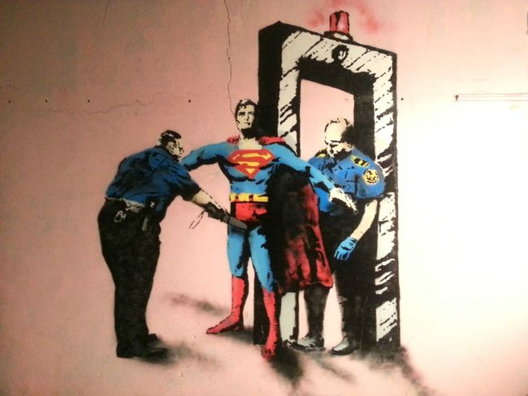
Benefits and drawbacks
Work from Graffiti Artist Priest
http://www.fatcap.com/uploads/sht/20103/bgp_3086a21504236dc88f45a499d62df5c751500e63.jpg

Slide 23
drawbacks
Open digital learning environments are
often more difficult to instruct in because of transparency, unpredictability, and expertise requirements
not yet well researched
often somewhat complex as there are several underpinning philosophical design frameworks
often sensationalized by the media and other sources so as to overemphasize the benefits and likely outcomes without proper grounding in research
Digital technologies are
often not used, or misused, in the traditional learning environment
have different affordances than face-to-face learning that are not often capitalized on for education
pose challenges in the traditional and dominant quantitative, standardized, measured perspectives

Slide 24
Benefits
Open learning environments are
often flexible and motivating for learners
good at fostering a participative community of learners
great for modeling, removing politics from the learning environment, and giving learners support to become self sufficient
centered around connections, sharing, access, transparency, and freedom (removing barriers and inhibitors)
often collaboratively developed and maintained, thus resulting in a more robust design that is often more sensitive to cultural, diversity, perspectival, and other considerations
designed systems with clear and open feedback processes and lines of communication built in, thus reducing the prevalence of poor instruction and improving the execution of the course design through communication (perpetual formative evaluation)

Slide 25
Conclusion
Open Education practices are in a different paradigm from traditional education
Open Education is a “Grand Experiment” where the power is redistributed to the learners and the courses operate under the design and guidance of educators
We are (at least I am) tired of being MOOCed to death
MOOCs are one type of Open Education Design and the term is often misused- some “MOOCs” aren’t even open
There are different types of Open Education Designs, and we can differentiate and classify them by their characteristics
There are drawbacks and benefits

Slide 26
The path
Openness
Designing Open Learning Environments
OEDs Taxonomy
Benefits and Drawbacks
Conclusion
http-//www.kdsdesign.co.uk/STAIRS

Slide 27
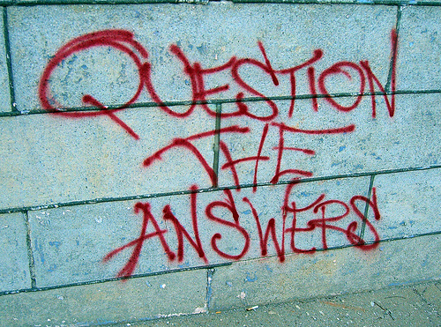
Questions?
http://farm4.static.flickr.com/3394/3526522573_8f40a675b6.jpg

Slide 28
Contact
You can connect with me at:
WWW: fredwbaker.com
Twitter: @fredwbaker
Email: fredwbaker@gmail.com

Slide 29
References
Baker III, F.W. (2012). Unshackling Future Minds: How including openness in
teacher education can avoid insurrection and usher in a new era of collaboration. In P. Resta (Ed.), Proceedings of Society for Information Technology & Teacher Education International Conference 2012 (pp. 1488-1493). Chesapeake, VA: AACE. Retrieved from
http:// www.editlib.org/p39793/proceeding_39793.pdf.
Baker III, F. W., & Surry, D. W. (in press). Open Education Designs: A Taxonomy for Differentiating and Classifying Open Learning Environments. Paper accepted for the Annual Conference of the Society for Information Technology in Teacher Education (SITE). New Orleans, LA.
IBM, (n.d.) What is big data? IBM. Retrieved 3-17-13 from http://
www-01.ibm.com/software/data/bigdata/
Tunnell, D. (1975). Open Education: an expression in search of a definition. In Nyberg, D. (1975). The Philosophy of Open Education (pp.14-23). London: Routledge & Kegan Paul, Ltd.

