Slide 1
The Nature of Open Education Course Designs
Fredrick w. Baker iii
Resources Available at:
www.fredwbaker.com/20th-annual-research-forum

Slide 2
Philosophy of Open Education
Principles of Openness
Transparency
Freedom (free from barriers/inhibitors)
Sharing
Access
Learner Agency
Connectivity
Open Learning Environment Emphasizes:
Open Pedagogy & Scholarship
Collaborative & Participatory Learning
Performance Assessments over Standardized Assessments
Formal Evaluation & Transparent Feedback
Modeling & Scaffolding
Holistic Perspectives on Learners

Slide 3
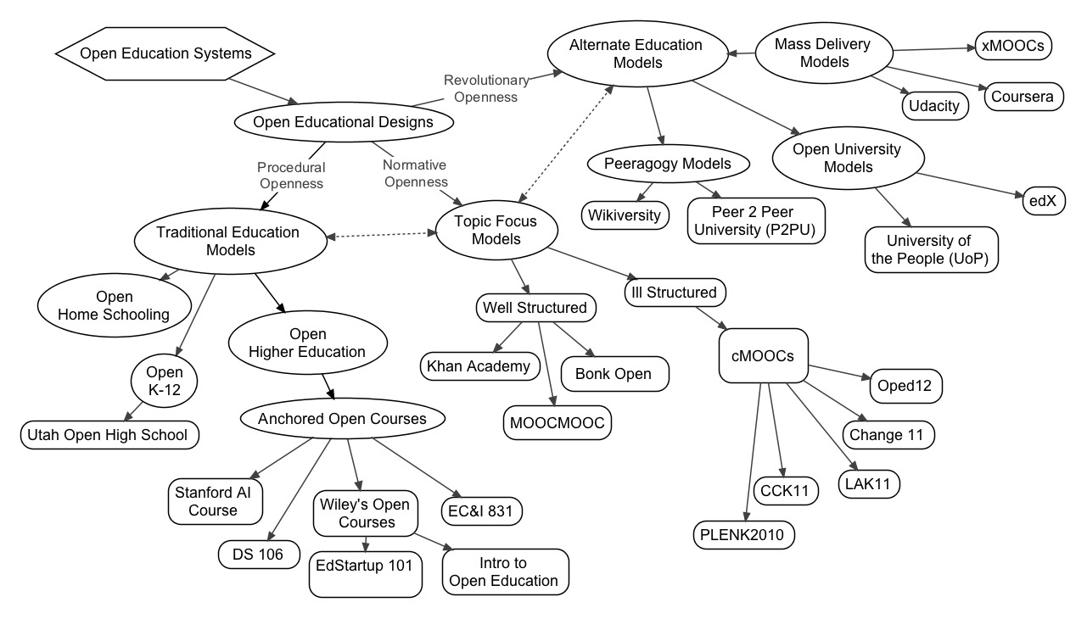
Taxonomy of Open Education Designs
Reference:
(Baker III, F.W., and Surry, D.W., 2013)

Slide 4
Taxonomy of Open Education Designs
Alternate Education Models (Revolutionary Openness):
Seek to replace existing educational structures
Examples: Coursera, Udacity
Topic Focus Models (Normative Openness):
Seek to create an ideal, universal education structure
Examples: #Change11 MOOC, Khan Academy
Traditional Education Structures (Procedural Openness):
Seek to modify traditional structures to be more open and connected
Examples: DS106 at University of Mary Washington, David Wiley’s Introduction to Open Education course at Brigham Young University
Reference:
(Baker III, F.W., and Surry, D.W., 2013)

Slide 5
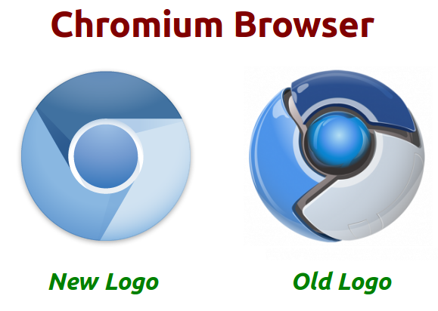
Open Digital Technologies

Slide 6
Connective Social Digital Technologies

Slide 7
Open Education as Experimentation
Open Education and the rise of digital technologies is enabling a grand experiment in how we approach education.
Traditional education structures are giving way to new methods of teaching and learning where educators and students are constantly learning and growing, expanding their skills, and leaving their comfort zones.
Organic systemic structures grow between learners, experts, educators, and people with common interests so they are able to collaborate on ideas through sharing and processing.
It is a dialogue of openness.

Slide 8
Important Questions in Open Learning Design
Who owns/controls the data?
2.5 quintillion bytes per day according to IBM (IBM, 2013)
How do we define, operationalize, measure, and track success?
Assessment types, constraints, objectives, etc.
How do we build in scaffolding, authenticity, transformative learning, and participation while retaining learner agency and freedom?
Resource provision, assignment development, procedures and requirements, etc.
How do we research and implement innovative and effective learning practices without dictating methods and approaches?
Top down approach vs. bottom up, design based research vs. theoretically driven or practically driven, etc.
Does technology drive education decisions, or does education drive technology decisions?
Shift toward hybrid/online dominant education

Slide 9
drawbacks
Open digital learning environments are
often more difficult to instruct in because of transparency, unpredictability, and expertise requirements
not yet well researched
often somewhat complex as there are several underpinning philosophical design frameworks
often sensationalized by the media and other sources so as to overemphasize the benefits and likely outcomes
Digital technologies are
often not used, or misused, in the learning environment
have different affordances than face-to-face learning that are not often capitalized on for education
pose challenges in the traditional and dominant quantitative, standardized, measured perspectives

Slide 10
Benefits
Open learning environments are
often flexible and motivating for learners
good at fostering a participative community of learners
great for modeling, removing politics from the learning environment, and giving learners support to become self sufficient
centered around connections, sharing, access, transparency, and removing barriers and inhibitors
often collaboratively developed and maintained, thus resulting in a more robust design that is often more sensitive to cultural, diversity, perspectival, and other considerations
organic systems with clear and open feedback systems and lines of communication built in, thus reducing poor instruction and improving the execution of the course design through communication

Slide 11
Contact
You can connect with me at:
WWW: fredwbaker.com
Twitter: @fredwbaker
Email: fredwbaker@gmail.com

Slide 12
References
Baker III, F. W., & Surry, D. W. (in press). Open Education Designs: A Taxonomy for
Differentiating and Classifying Open Learning Environments. Paper accepted for the
Annual Conference of the Society for Information Technology in Teacher Education (SITE).
New Orleans, LA.
IBM, (n.d.) What is big data? IBM. Retrieved 3-17-13 from http://www-01.ibm.com/software/
data/bigdata/

