Slide 1
Creating a connected open classroom
Tools, Assignments, and Guidelines
Fredrick W. Baker III
University of South Alabama

Slide 2
Additional Resources available at
http://www.fredwbaker.com/2013cotl

Slide 3
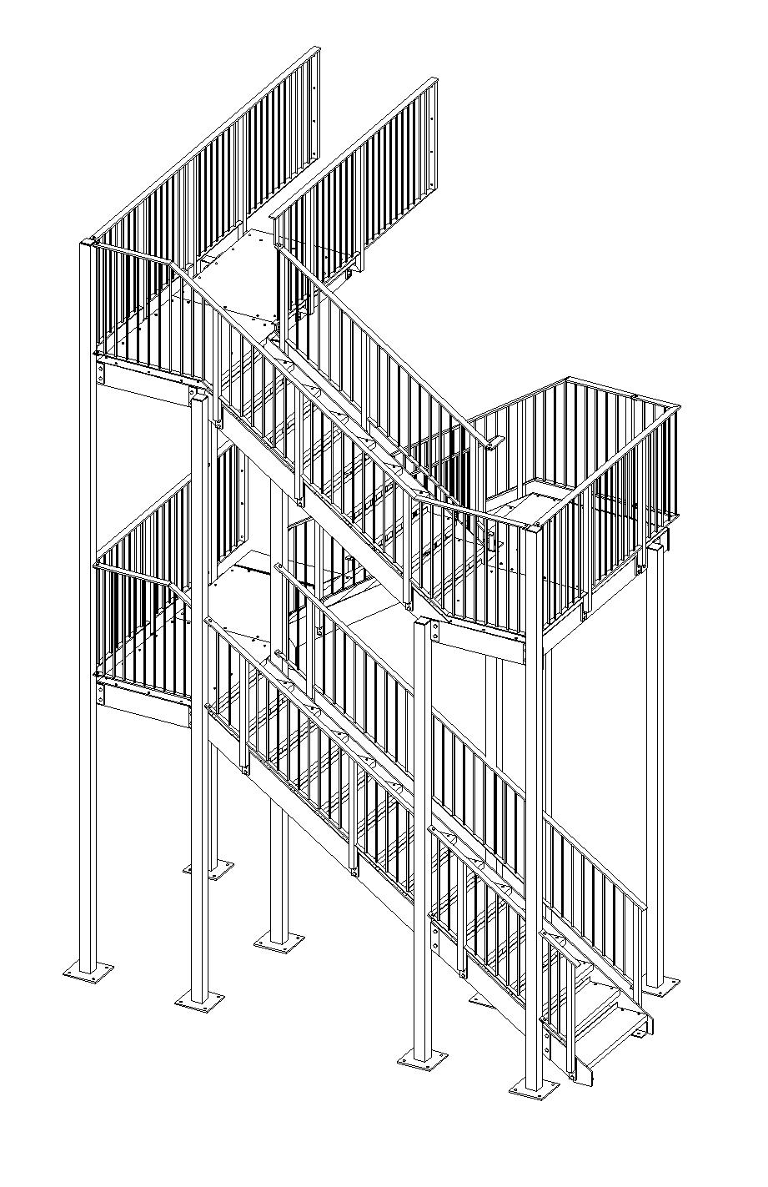
The path
What is Openness?
Why Openness?
How?
Tools, Assignments, and Guidelines
When?
Where?
More?
http-//www.kdsdesign.co.uk/STAIRS

Slide 4
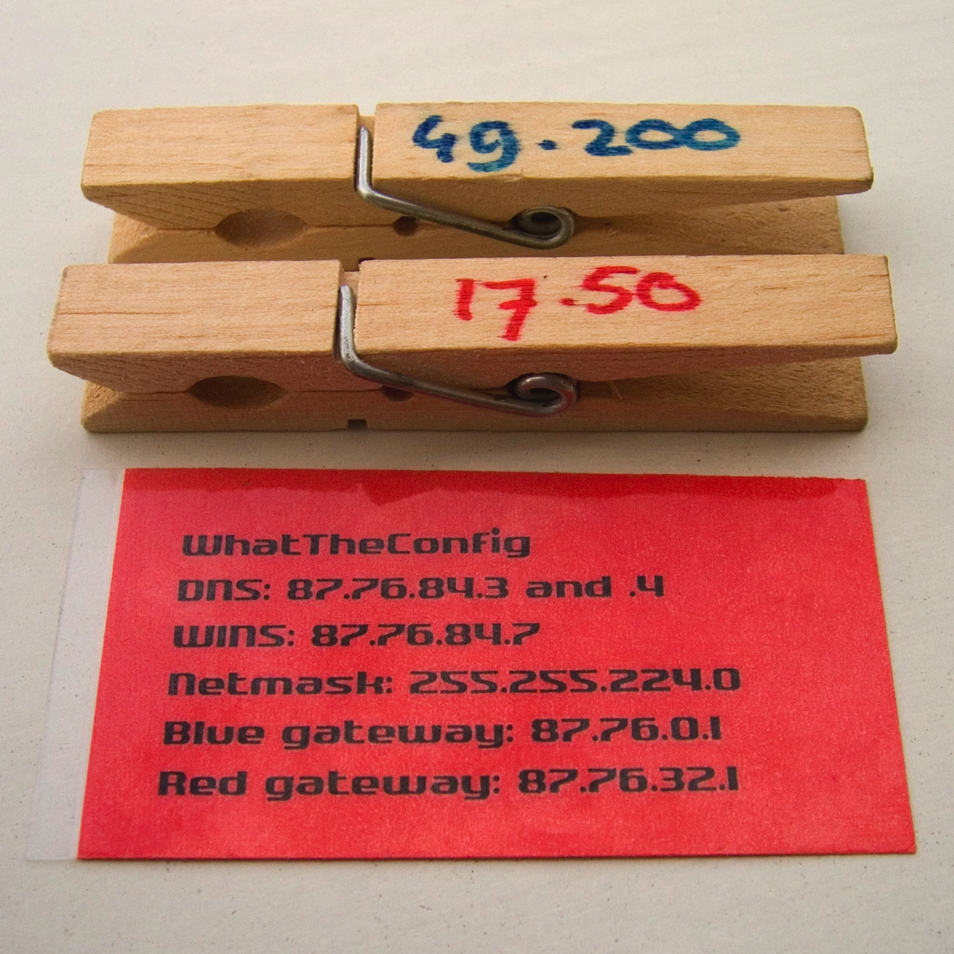
What?
http://upload.wikimedia.org/wikipedia/commons/6/6a/Peg_dhcp_from_what_the_hack_holland_2005.jpg

Slide 5
What is openness?
Openness is a philosophy that emphasizes the value of all people.
It strives to be inclusive of everyone through encouraging transparency, reduction of barriers, sharing, accessibility, and connectivity.

Slide 6
What is open education?
Open education is a grand experiment in designing a richer, more inclusive, flexible, transparent, learning experience for everyone.
It is collaborative and human centered.

Slide 7
Why?
http://www.flickr.com/photos/opensourceway/6555466069/sizes/l/in/photostream/

Slide 8
Why openness?
Openness:
Provides a social context for the course and content
Enables learners to participate in a community of interest
Allows learners to connect with a larger community of experience
(e.g., a research class can connect with research experts and practitioners)

Slide 9
Why openness?
Openness:
Helps limit marginalization
encouraging inclusiveness
distributing the power to everyone
Encourages active and authentic engagement
giving learners ownership of their experience
allowing for transparency
Enriches learning and encourages connectivity
developing porous boundaries
allow access, sharing, and participation with larger community

Slide 10
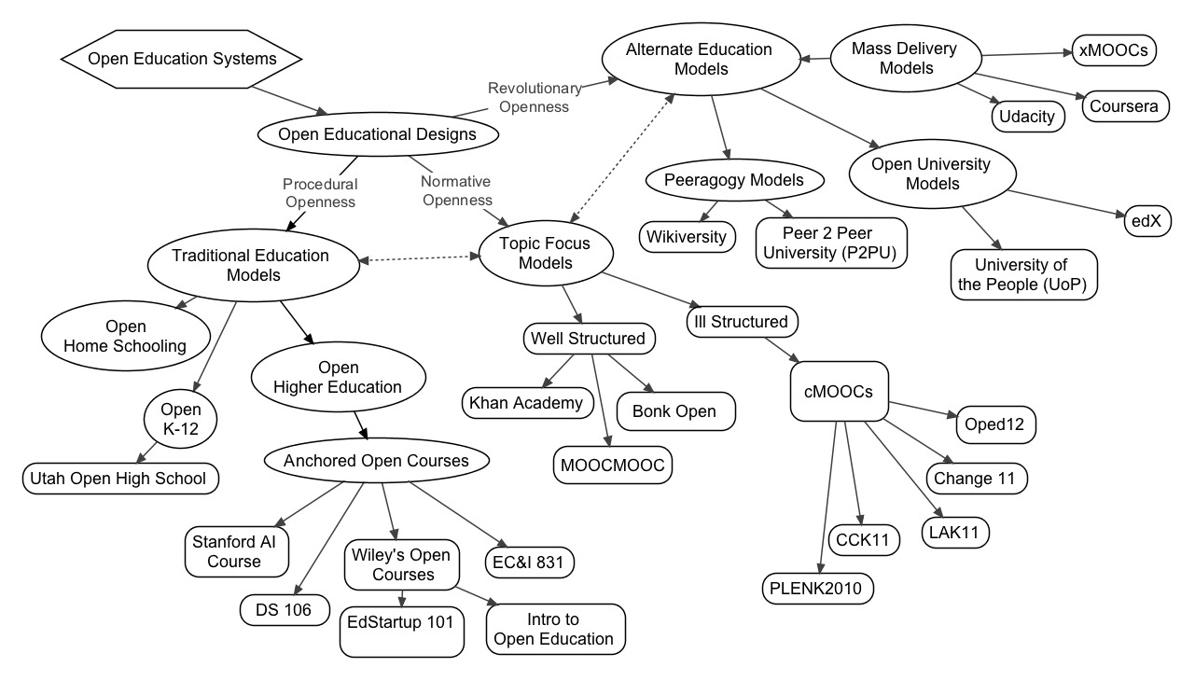
How?
Baker III, F. W., & Surry, D. W. (2013). Open Education Designs: A Taxonomy for Differentiating and Classifying Open Learning Environments. Paper accepted for the Annual Conference of the Society for Information Technology in Teacher Education (SITE). New Orleans, LA.

Slide 11
common rules for the Open classroom
Freedom Rule
Learners should have freedom [and ownership] over their own educational endeavors (Agency)
Environment Rule
Must create resource rich environments with a plethora of opportunities
Personalization Rule
Instruction that is personalized where possible and obligates learners to educationally worthwhile goals
Respect Rule
Respect for the learners, always.
Tunnell, D. (1975). Open Education: an expression in search of a definition. In Nyberg, D. (1975). The Philosophy of Open Education (pp.14-23). London: Routledge & Kegan Paul, Ltd.

Slide 12
Open learning environments
Open learning environments feature:
Learner collaboration with peers and larger community,
Universal ownership of the class experience,
Porous boundaries that allow for flexibility in learning,
Transparency in learning and clear feedback systems,
Openly licensed sharable content,
Public sharing, connectivity, and authentic learning.
These are enabled by policies, design decisions, and freedoms bestowed on the learners and larger community.

Slide 13
Open learning environments
Two main concerns in developing an open learning environment are:
Transparency
Reducing barriers

Slide 14
Transparency
Open Learning Environments seek to foster transparency in the learning environment. Many times this is done through:
Operating in public spaces
Aggregated individual or class blogs, websites, Twitter, Google +, etc.
Using publicly accessible content and resources
Open Access journals, professional’s blogs, open textbooks, content, and resources such as MITs Open CourseWare or Khan Academy.
Encouraging collaboration and connection
Using Diigo, Open Study, Google Drive documents, groupwork assignments, encouraging a public service such as editing a Wikipedia page, etc.

Slide 15
Connective/Social Digital Technologies

Slide 16
Reduced barriers
Open Learning Environments also seek to be permissive and reduce barriers in the learning environment. Many times this is done through:
Enabling student agency
Allowing learners to generate own assignments, choose topics, or select where points are distributed, or modifying the content to focus on self-selected areas.
Encouraging democratic connection/collaboration
Allowing learners to select and form/break their own groups, encouraging them to engage and connect with experts and professionals outside of the class, and giving them a voice and the power and right to use it.
Building in real time feedback structures
Design feedback systems into the course so the learners are not penalized for dissenting but so the instructor obtains an immediate understanding of what is happening.

Slide 17
The caveat
Open learning environments…
DEMAND AUTHENTICITY!
Can’t “use Twitter this week” and then never touch it again.
Can’t “let students select their own groups” while forcing them to work with the moocher (i.e., uninvolved and uninterested) students.
Can’t “let students choose a project topic” and then restrict them with so many guidelines they lose interest.
Can’t “expose them to content” by burying them under so many readings and assignments that they can’t take it all in.

Slide 18
The good news
Openness is a continuous construct.
You don’t have to be fully transparent or give away all your course materials for free!
Making decisions that tend toward increasing transparency and reducing barriers is a great start!

Slide 19
Some Questions to ask yourself
In my course, “How can I…?”
better allow my students to connect with each other and the community socially?
allow the learners to access and share the course content even after they close my course shell?
better enable students to see my topic in its real world setting?
modify the course rules to encourage engagement and creativity with the content?
foster a sense of community in my course?
discover and reduce the impact of rules and other aspects of my course that inhibit authentic engagement and learning?
create real time formative feedback systems that will allow me to know about my student’s perspectives and experiences while there is still time to do something about it?

Slide 20
When?
http://opendesignnow.org/wp-content/themes/odn/images/clip.png

Slide 21
When?
Today? Tomorrow? Next Week? Never?
It really is up to you.
You have the power to empower and encourage your students.

Slide 22
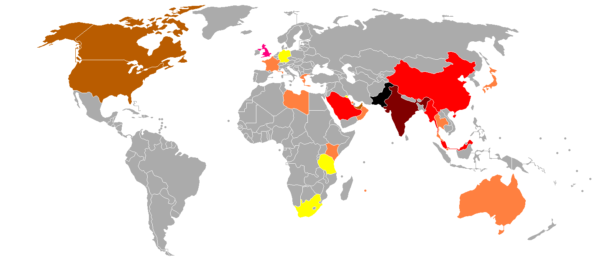
Where?
http://upload.wikimedia.org/wikipedia/commons/6/63/Countries_where_Punjabi_is_spoken.png

Slide 23
Where?
Start where you have control:
Your course.
Experiment. Play. Ask and engage.
Learn how to foster community, empower students, and improve the experience for the learners using feedback and sharing the power.

Slide 24
Where?
Move out as you feel comfortable or feel it important.
Open Education is an experiment.
When we share what we learn, we all benefit.

Slide 25
More?
I have active examples of open courses and suggested resources at the presentation site.
www.fredwbaker.com/2013cotl
The slides and (later) the audio are there as well.

Slide 26
The path
What is Openness?
Why Openness?
How?
Tools, Assignments, and Guidelines
When?
Where?
More?
http-//www.kdsdesign.co.uk/STAIRS

Slide 27
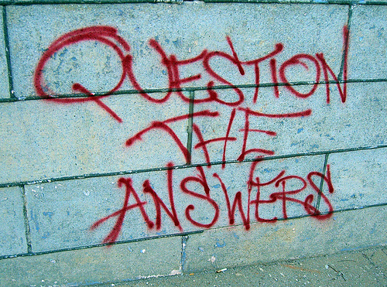
Questions?
http://farm4.static.flickr.com/3394/3526522573_8f40a675b6.jpg

Slide 28
Contact
You can connect with me at:
WWW: fredwbaker.com
Twitter: @fredwbaker
Email: fredwbaker@gmail.com

